Slide 1
Components of Artificial intelligence
GREESHMA K
AI & DS

Slide 2
Artificial intelligence
Artificial intelligence is the simulation of human intelligence processes by machines, especially computer systems.
The components of AI enable machines to perform tasks that would typically require human cognitive abilities.

Slide 3
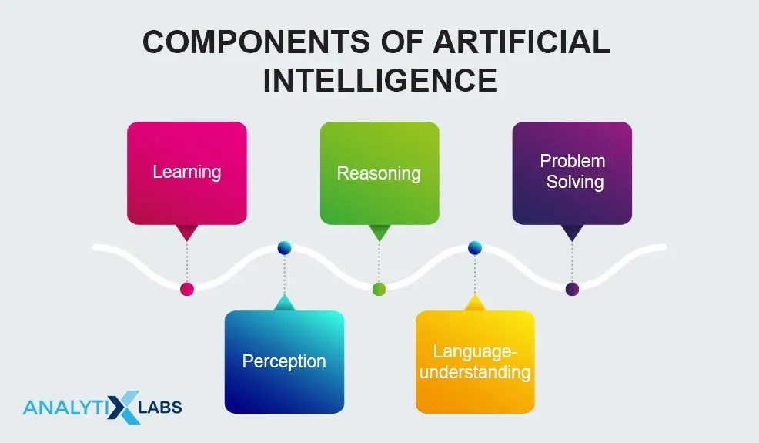

Slide 4
Learning
AI learning refers to the process by which machines acquire knowledge, skills, and the ability to make decisions based on data and experience.

Slide 5
Type of Learning
Supervised Learning: In supervised learning, the AI system is trained on labeled data, where it learns to make predictions or classify inputs based on the provided examples.
Unsupervised Learning: Unsupervised learning involves discovering patterns, structures, or relationships in data without explicit supervision. Clustering and dimensionality reduction are common unsupervised learning tasks.
Reinforcement Learning: In reinforcement learning, AI agents learn by interacting with an environment and receiving feedback in the form of rewards or penalties. They develop strategies to maximize their cumulative rewards.

Slide 6
Perception
Ability of AI systems to gather and interpret information from the world around them.
This component involves various processes through which machines acquire data from the environment, understand it, and use it for decision-making.
Perception is a vital component of AI systems, especially in areas such as computer vision, natural language processing, autonomous vehicles, and robotics.

Slide 7
Key concept in Perception
Sensors
Data processing
Feature extraction
Interpretation
Integration with other components

Slide 8
Language understanding
Language understanding is a subfield of artificial intelligence (AI) and natural language processing (NLP) that focuses on enabling computers to comprehend and interpret human language.
It involves the ability to analyze and extract meaning from text or speech, making it a crucial component of various AI applications, including chatbots, virtual assistants, machine translation, sentiment analysis, and more.

Slide 9
Here are the key aspects of language understanding:
Text and Speech Processing
Syntax and Grammar Analysis
Sentimental Analysis
Semantics understanding
Contextual understanding
Ambiguity Handling

Slide 10
Reasoning
Reasoning refers to the process by which AI systems make decisions, draw conclusions, and solve problems based on the information and rules they have been programmed with.
It allows machines to simulate human-like thinking and problem-solving.

Slide 11
Type of Reasoning
Deductive Reasoning-AI systems use deductive reasoning to derive specific conclusions from general knowledge or rules. For instance, an AI expert system might use deductive reasoning to diagnose a medical condition based on a set of symptoms and medical rules.
Inductive Reasoning-AI systems can employ inductive reasoning to make generalizations from specific data. Machine learning, a subset of AI, often relies on inductive reasoning to recognize patterns and make predictions based on training data.

Slide 12
Problem Solving
Problem solving involves developing algorithms and approaches to find solutions to complex, often dynamic problems.
Some of Problem solving technique are
Search Algorithms
Heuristic Methods
Constraint Satisfaction Problem

Slide 13
Search Algorithm
They are used to navigate through possible states or solutions to find an optimal or satisfactory result.
Common search algorithms include depth-first search, breadth-first search, A* search algorithm.
Search algorithms are widely used in areas like game-playing AI route planning, and puzzle-solving.

Slide 14
Heuristic Method
Heuristic methods incorporate domain-specific knowledge or rules to guide the search process more efficiently. They can make informed decisions about which paths or solutions to explore.
A* search, for example, uses a heuristic function to estimate the cost of reaching a goal from a given state.

Slide 15
Conclusion
In a comprehensive AI system, the components of perception, learning, problem-solving, language understanding, and reasoning work together synergistically to achieve intelligent behavior and perform various tasks.
The interaction and cooperation of these components are essential for creating intelligent and adaptable AI systems.

